Slide 1

Almost Event-Rate Independent Monitoring of Metric Temporal Logic
David Basin, Bhargav Bhatt, and Dmitriy Traytel
ETH Zurich
Notes:
Good Afternoon
Will be talking about notion of event-rate independence in monitoring temporal logic.
This is joint work with my advisers David Basin and Dmitriy Traytel.
I will first explain and motivate the problem and then give an overview of our solution.

Slide 2
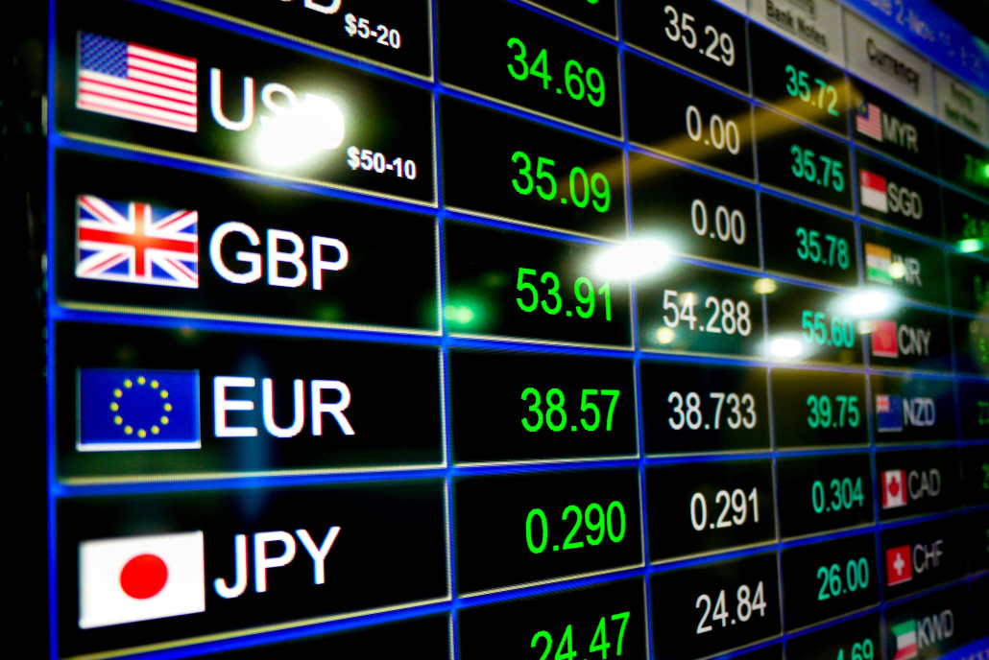



Online Monitoring Problem
Property: check if CHF/EUR has been increasing since the fall of SEK/EUR within the previous 3 hours.
EVENTS
Timepoints:
1
2
3
Timestamps:
09:00
10:00
12:00
18:00
↑_{CHF}
↓_{SEK}
↑_{CHF}
↑_{SEK}
↓_{CHF}
↑_{SEK}
↓_{CHF}
↓_{SEK}
Propositions:
MONITOR:
VERDICTS:
Or
Notes:
- So what is the online monitoring problem?
Suppose you have access to forex market in real-time ….....
Want to observe how the currency values are logically related.
Prop: Has the value of Franc/Euro been increasing since the fall of KRONOR/Eur within the previous three hours...
From the raw data .... Extract the relevant information.
Timepoint,stamps events ...........
MONOTONIC but may not be strictly increasing.
MTL is a logic used to specify such properties
Monitors INPUT: Event-stream and Property
OUTPUT: verdicts

Slide 3

Properties That Talk About The Future
Traditional Monitor
t0
t1
t2
t3
t4
t5
Out of
Memory
Output
@t0:
@t1:
@t2:
@t3:
Notes:
In previous SLIDE the property talked about the PAST, but what if the property talks about FUTURE
From a USERS PERSPECTIVE, traditional monitors work as follows:

Slide 4
Our Contribution
A New Monitor
t0
t1
t2
t3
t4
t5
...
Output
Number of events in monitor’s buffer dependent only on property, not on trace
@t1= @t2
@t0:
@t3:
@t1:
@t4= @t5
...
Notes:
- We present a monitor that works differently,
SYMBOLIC REPERESENTATION OF THE VERDICT
- We consider specifications in MTL

Slide 5
MTL : Syntax and Semantics
Atomic Propositions
(Events)
Boolean operators
Temporal operators : Since, Until
Intervals over integers, e.g. [2,7] , [3,∞)
Semantics of Since
Semantics of Until
Property: check if CHF/USD has been increasing since the fall SEK/USD within the previous 3 hours.
↑_{CHF}
↓_{SEK}
Notes:
MTL is a specification language used to formally specify properties of systems.
SYNTAX is INDUCTIVELY defined as….....
Atomic, boolean, temporal, .. ANNOTATED with Intervals over INTEGERS.
With this in hand, if we look back at the property, it can be modeled as …...........

Slide 6
Overview
Past-MTL
MTL (Past and Future)
Trace-Length Independence
Trace-Length Independence
State of the art
monitoring algorithms
Almost*
Event-Rate Independence
Event-Rate Independence
??
AERIAL
State of the art
monitoring algorithms
Notes:
Monitoring for metric temporal logic is a well studied , SEVERAL algorithms present.
A DESIRED Notion for monitors is TLI, talks about scalability with regard to volume of data, and hence PRACTICALLY RELEVANT.
We propose a stronger notion …................, in some sense characterie performance w.r.t velocity
Turns out that for past-MTL , properties that talk about …................
Fill this void
-to understand this slide, lets look into details o

Slide 7
Trace-length Independence (TLI)
Space complexity
Formula-size
Time complexity
Trace-length
Notes:
Complexity analysis of monitors is w.r.t ….......
Time complexities are modest for monitors , MAIN issue is space.

Slide 8


Trace-length Independence (TLI)
independent of timepoint
Timepoints:
i
i+1
1
2
3
Verdicts:
Event-rate Independence (ERI)
07:00
08:00
09:00
10:00
1M events
5M events
10M events
4M events
Notes:
- For a monitor to output verdict at i, if AMOUNT of trace it stores is independent ..
In OTHER WORDS …............
Suppose you have a situation where number events per time-stamp is varying
1M @day1 ..............

Slide 9
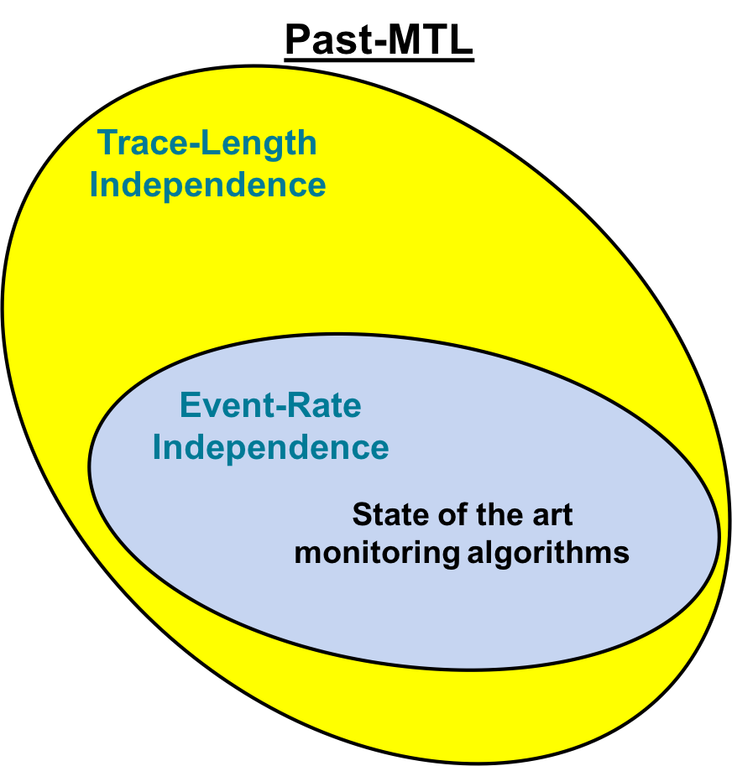

Overview
??
Past
Future
Notes:
Looking back at the big picture, ERI is a HARSHER TASKMASTER for FUTURE >> PAST .
TLI and ERI coincide for traces with unbounded event-rate. Hence existing algo are not TLI on unbounded traces. Discussion in paper.

Slide 10
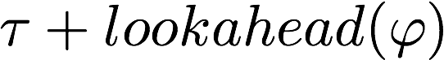

Why are Future operators difficult?
Previous Approaches
Depends on event-rate.
Monitors that output verdicts in order
are not ERI.
eg.: Monpoly
or
i
j
Our Approach
or
Verdict:
or
or
or
*
Logarithmic space in event-rate needed to store j as a number
= @i
= @j
‘Equivalence’ verdicts
Notes:
To output the verdict at Tau, monitor requires events that happen in the future. Hence monitor aits till all required events have been seen

Slide 11
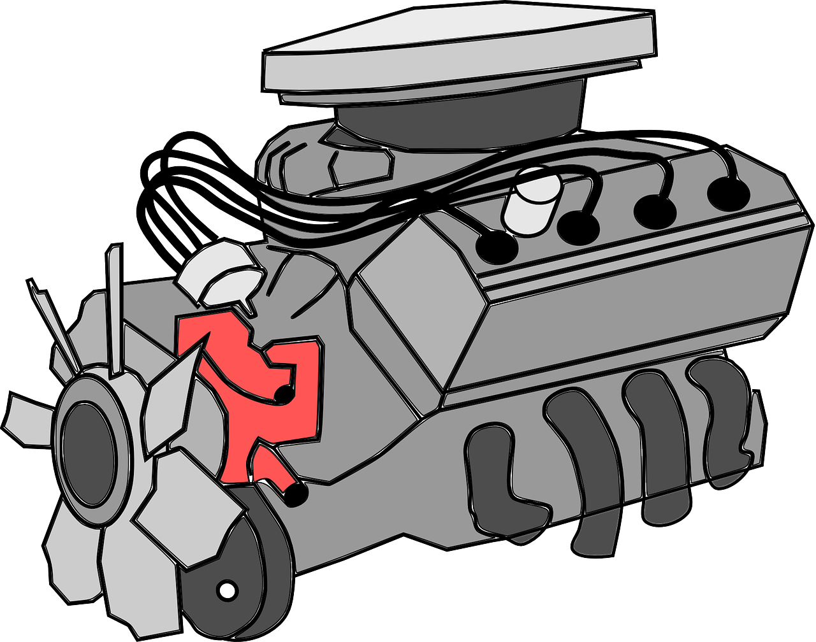
AERIAL (Almost Event Rate Independent MTL monitoring)
Dynamic Programming Based Technique using the recursive equations characterizing Since and Until :
Past:
Previous Timepoint
Future:
Next Timepoint
Notes:
Overview of our algorithm.
It is a Dynamic Prog….. At the heart of our algorithm are these rec eq. Capture the semantics of Since and Until
Do not have to parse everything here . What is important is ….....
This is basically the ENGINE of our algo, which helps us to propagate through the trace.
Our Algo can be explained best as a series of refinements.
Lets start with simplest version

Slide 12
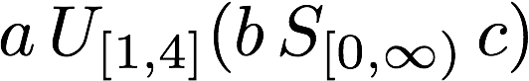
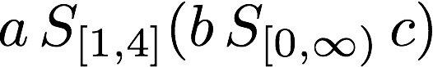
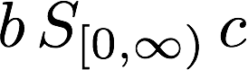
AERIAL (Almost Event Rate Independent MTL monitoring)
Algorithm can be seen as a series of refinements
Step 2 : MTL (Past and Future)
Step 1 : Past-MTL
Step 0 : Past-LTL
Notes:
SOME TOY EXAMPLES

Slide 13
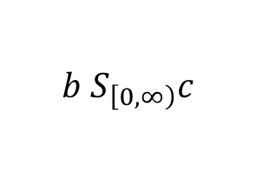
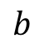
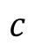
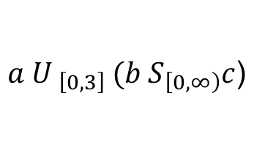
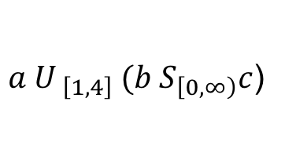
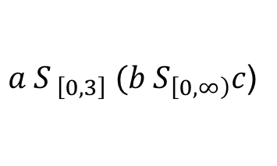
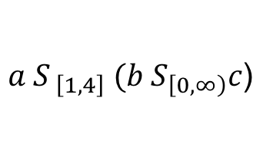
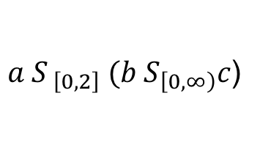
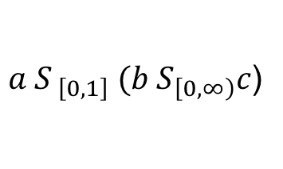
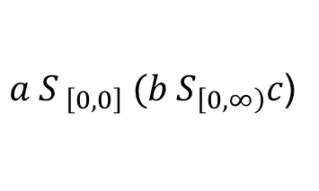
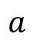
Step 0 : Past LTL (Havelund and Rosu, 2002)
Step 2 : Add support for Future
Step 1 : Add support for Past-MTL
1
2
3
4
5
$$a$$
T
$$b$$
T
F
T
F
$$c$$
F
T
T
F
$$b S_{\left[0,∞\right)}c$$
F
T
T
F
T
$a S_{ \left[0,0\right]} (b{ S}_{\left[0,∞\right)}c$)
$a S_{ \left[0,1\right]} (b{ S}_{\left[0,∞\right)}c$)
$a S_{ \left[0,2\right]} (b{ S}_{\left[0,∞\right)}c$)
$a U_{ \left[0,3\right]} (b{ S}_{\left[0,∞\right)}c$)
$a S_{ \left[0,3\right]} (b{ S}_{\left[0,∞\right)}c$)
$a S_{ \left[1,4\right]} (b{ S}_{\left[0,∞\right)}c$)
bexp
bexp
x1 ⋀ x2
x2 ⋀ x1
$a U_{ \left[1,4\right]} (b{ S}_{\left[0,∞\right)}c$)
Boolean Expressions with variables pointing to next column
Verdict:
= @i
13
Notes:
Finitely many semantically distinct expressions,

Slide 14
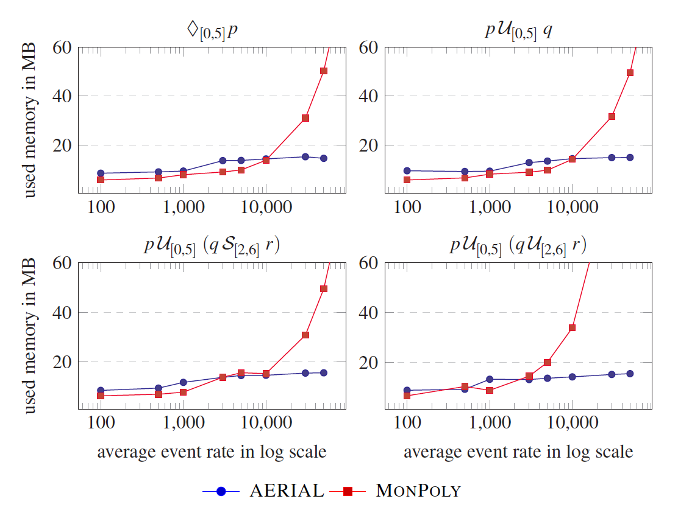
Experimental Evaluation
Notes:
We IMPLEMENTED the algorithm in Standard-ML in less than 700 LOC.
X-AXIS is the average event-rate of traces in log-scale

Slide 15
Conclusion
theoretically interesting and practically relevant for monitoring in Big Data domains
New Notion: Event-Rate Independence
New Algorithm: AERIAL, a monitor for MTL
New Idea: Out of order
In-order output
Space consumption linear in event-rate
or Equivalence
Boolean
verdicts
logarithmic
Future Work: Extend technique to more expressive logics (for timed properties)
Notes:
In conclusion, we identified a NEW notion of Event-Rate Independece, WHICH IS BOTH Theoreticall interesting and Prac…........................

Slide 16
Thank You
Almost Event-Rate Independent Monitoring of Metric Temporal Logic
Almost Event-Rate Independent Monitoring of Metric Temporal Logic
David Basin, Bhargav Bhatt, and Dmitriy Traytel
ETH Zurich

Slide 17
Conclusion
Notes:
In summary
Looked at the online monitoring problem, and the notion of trace length independence.
Proposed at a stronger criterion of ERI, which talks about performance w.r.t to velocity of stream

Slide 18
Unbounded Event-Rate
Timepoints:
1
2
3
4
5
6
7
8
9
10
11
...
(e₂,1)
(e₃,2)
(e₅,2)
(e₆,2)
(e₈,3)
(e₁₀,3)
(e₁₁,3)
...
(Event,Timestamp):
(e₁,1)
(e₄,2)
(e₇,3)
(e₉,3)
Event-Rate is roughly half of Trace-Length at any timepoint
(e,t) is repeated 2^{t} times
On this trace: Event-Rate dependence ➔ Trace-Length dependence
TLI and ERI coincide on unbounded event-rate traces
None of the existing monitors are TLI on unbounded Event-Rate traces.
Notes:
Sidestepping from the main storyline, here is an observation worth noting.
Consider the following trace, where the event (et,t) is repeated …......
Here the event-rate is roughly half of the trace-length.
- Ofcourse such traces do not occur often in practice,

